Slide 1




Efficient Estimation of Heat Kernel PageRank for Local Clustering
Renchi Yang, Xiaokui Xiao, Zhewei Wei,
Sourav S Bhowmick, Jun Zhao, Rong-Hua Li
July 2019
Notes:
Today I would like to present you with our efficient approximate algorithm of Heat Kernel PageRank for local graph clustering, which is a joint work with Professor Xiaokui, Zhewei, Sourav, Jun and Rong-Hua

Slide 2
Outline
Problem Definition & Applications
Deficiencies of Existing Solutions
Proposed solutions: TEA & TEA+
Experiments
Notes:
First, I would like to give you some backgrounds about the problem we studied, followed by a brief review of existing work.
Then our solutions will be introduced and finally we will show some interesting experimental results.

Slide 3
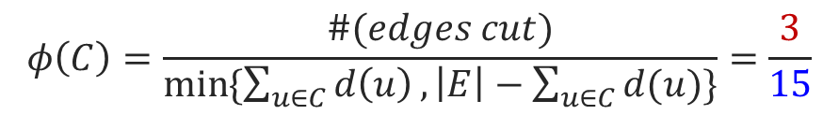
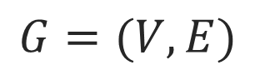
Problem Definition: Local Graph Clustering
Given an undirected graph G and seed node s, local clustering only explores a local neighborhood of s
finds a cluster C with minimal conductance
$$φ\left(C\right)=\frac{\#(edges cut)}{\min{\{\sum_{u∈C}{d\left(u\right)},\left|E\right|−\sum_{u∈C}{d(u)}\}}}=\frac{3}{15}$$
s
edge cut:
local cluster C
$$G=(V,E)$$
Notes:
Given a seed node s, a local graph clustering algorithm aims to find a cluster C surrounding s such that the cluster C has the minimal conductance
which is defined as, the ratio of the number of its edge cuts to the number of its total edges.
Note that each edge cut stands for the cluster’s external connection.
For example, there are 3 edge cuts and the number of edges is 15, as a result the conductance of C is 1 over 5

Slide 4
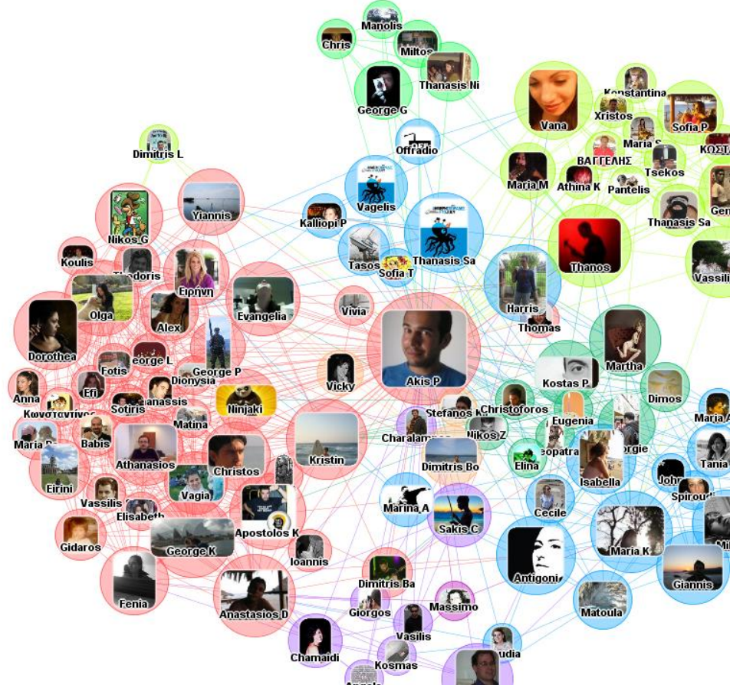

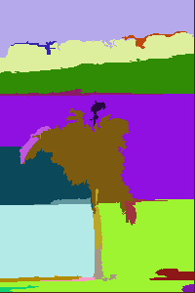
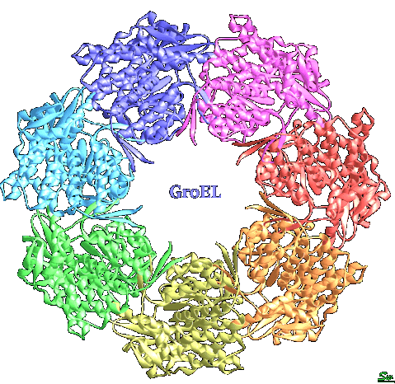
Applications
Community detection
[Leskovec et al. WWW’2010]
[Wang et al. VLDB’2015]
Image segmentation
[Felzenszwalb et al. IJCV’2004]
[Tolliver et al. CVPR’2006.]
Protein grouping
[Voevodski et al. BMC Bioinformatics’2009]
[Liao et al. Bioinformatics’2009]
Notes:
Local clustering has many applications, for instance, detecting communities on social networks, segmenting images as well as grouping protein in biological networks.

Slide 5
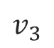


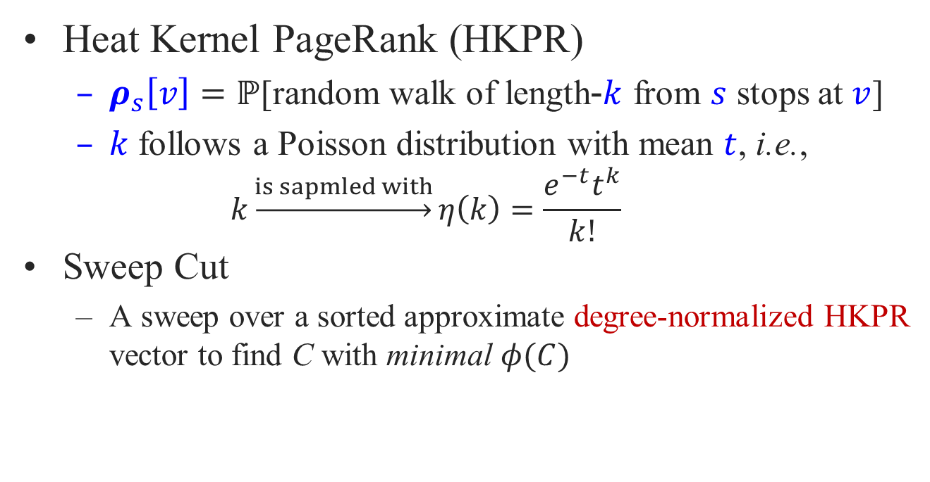
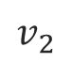
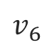


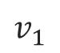
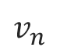


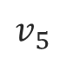
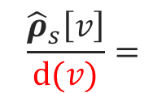
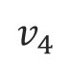

Problem Definition: Heat-Kernel-based Local Clustering
Heat Kernel PageRank (HKPR)
$ρ_{s}\left[v\right]=ℙ$[random walk of length-$k$ from $s$ stops at $v$]
$k$ follows a Poisson distribution with mean $t$, i.e., $k\underset{→}{is sapmled with}η\left(k\right)=\frac{e^{−t}t^{k}}{k!}$
Sweep Cut
A sweep over a sorted approximate degree-normalized HKPR vector to find C with minimal $φ(C)$
C
$$v_{1}$$
$$v_{2}$$
$$v_{3}$$
$$v_{4}$$
$$v_{5}$$
$$v_{6}$$
$$⋯$$
$$⋯$$
$$⋯$$
$$v_{n}$$
$$\frac{{\hat{ρ}}_{s}\left[v\right]}{d(v)}=$$
0.15
0.14
0.12
0.1
0.08
0.06
$$⋯$$
$$⋯$$
$$⋯$$
$$⋯$$
Notes:
The state-of-the-art solution for local graph clustering is based HKPR, short for Heat Kernel PageRank.
The Heat Kernel PageRank from s to v is defined as the probability that the random walk of a length k from s stops at v. In particular, the length k is sampled with Poisson probability and the expected length of a random walk is t.
Existing solutions all first compute approximate HKPR scores for a seed node s, and then sort nodes by their degree-normalized HKPR scores in descending order.
Finally, they perform a sweep over the sorted nodes to find a cut that has the minimal conductance and returns the cut as the cluster C.
Since the clustering quality highly relies on the ranking of nodes, recent algorithms all focus on computing approximate HKPR accurately.

Slide 6
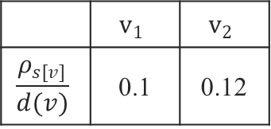


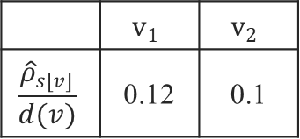
Deficiencies of Existing Solutions
HK-Relax
Promises same absolute-error guarantees in terms of the degree-normalized HKPR of all nodes
Exact HKPR
HK-Relax’s Results
 | $$v_{1}$$ | $$v_{2}$$
$$\frac{ρ_{s[v]}}{d(v)}$$ | 0.1 | 0.12
 | $$v_{1}$$ | $$v_{2}$$
$$\frac{{\hat{ρ}}_{s[v]}}{d(v)}$$ | 0.12 | 0.1
$$<$$
$$>$$
absolute error 0.02 for both, regardless of their degree-normalized HKPR
Notes:
There are mainly two algorithms for computing approximate HKPR. The first one is HK-Relax, which provides the degree normalized HKPR of all nodes with the same absolute error guarantees.
Suppose we have exact degree normalized HKPR for v1 and v2, which are 0.1 and 0.12 respectively. HK-Relax estimates the degree normalized HKPR of v1 and v2 as 0.12 and 0.1 respectively, both of which satisfy an absolute error 0.02. However, the ranking is incorrect.
Intuitively, we are supposed to provide much tighter error guarantees for those with small normalized HKPR, such that the errors would not overwhelm their HKPR and affect the ranking.
This suggests that relative error guarantee would be a better choice.

Slide 7
Deficiencies of Existing Solutions
ClusterHKPR
Promises relative-error guarantees in terms of the degree-normalized HKPR of some nodes
Incurs a high complexity due to a large number of random walks
Notes:
ClusterHKPR is a Monte-Carlo based method, which provides relative error guarantees to some nodes.
However, it requires a large number of random walks, leading to an expensive overhead.

Slide 8
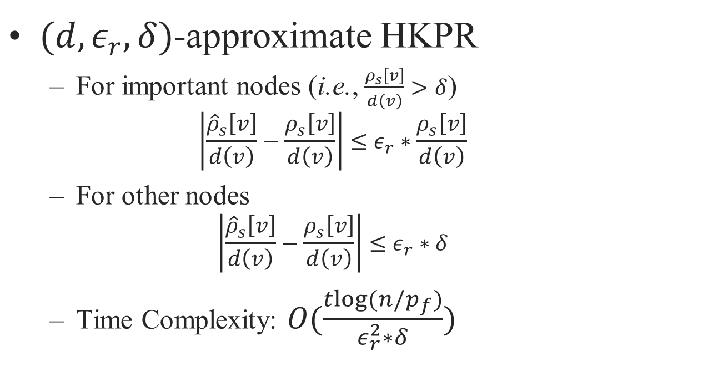
Our Solution
$(d,ε_{r},δ)$-approximate HKPR
For important nodes (i.e., $\frac{ρ_{s}\left[v\right]}{d\left(v\right)}>δ$) $\left|\frac{{\hat{ρ}}_{s}\left[v\right]}{d\left(v\right)}−\frac{ρ_{s}\left[v\right]}{d\left(v\right)}\right|≤ε_{r}∗\frac{ρ_{s}\left[v\right]}{d\left(v\right)}$
For other nodes $\left|\frac{{\hat{ρ}}_{s}\left[v\right]}{d\left(v\right)}−\frac{ρ_{s}\left[v\right]}{d\left(v\right)}\right|≤ε_{r}∗δ$
Time Complexity: $O(\frac{tlog(n/p_{f})}{ε_{r}^{2}∗δ})$
Notes:
Motivated by the deficiencies of previous work, we proposed to compute (d epsilon, delta)-approximate HKPR for each node.
More specifically, for the nodes with large degree-normalized HKPR, we promise relative error guarantees
But for other nodes, we provide absolute error guarantees in terms of degree-normalized HKPR.
Our methods run in time that almost linear the size of the input graph and the error threshold, which is much more efficient compared to HK-Relax and ClusterHKPR, especially on large graphs.

Slide 9
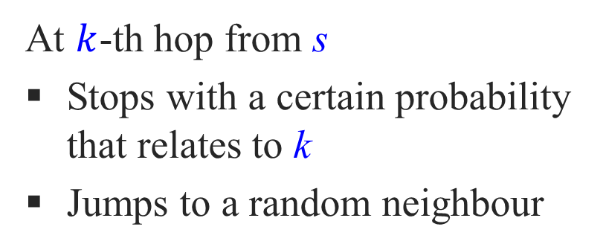
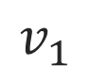
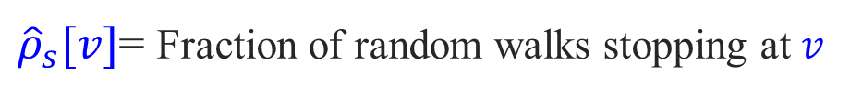
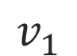
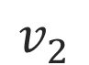

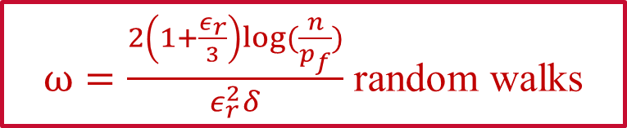
Monte-Carlo Random Walks
$$v_{1}$$
At $k$-th hop from s
Stops with a certain probability that relates to k
Jumps to a random neighbour
$$v_{1}$$
s
$$v_{2}$$
$$v_{1}$$
${\hat{ρ}}_{s}[v]$= Fraction of random walks stopping at $v$
$ω=\frac{2\left(1+\frac{ε_{r}}{3}\right)log⁡(\frac{n}{p_{f}})}{ε_{r}^{2}δ}$ random walks
Inefficient!
Notes:
A simple and straightforward way to compute (d epsilon, delta)-approximate HKPR is utilizing Monte-Carlo random walks.
That is, performing random walks from seed node s, at k th hop from s, each random walk either terminates with a certain probability or jumps to a random neighbor of the current node.
The HKPR of each node v with respect to s is estimated by the fraction of random walks that terminates at v.
However, the Monte-Carlo approach requires a large number of random walks, thereby leading to inefficiency

Slide 10
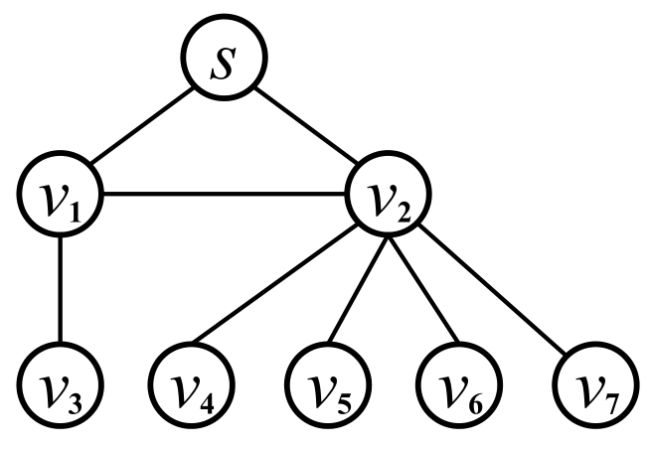
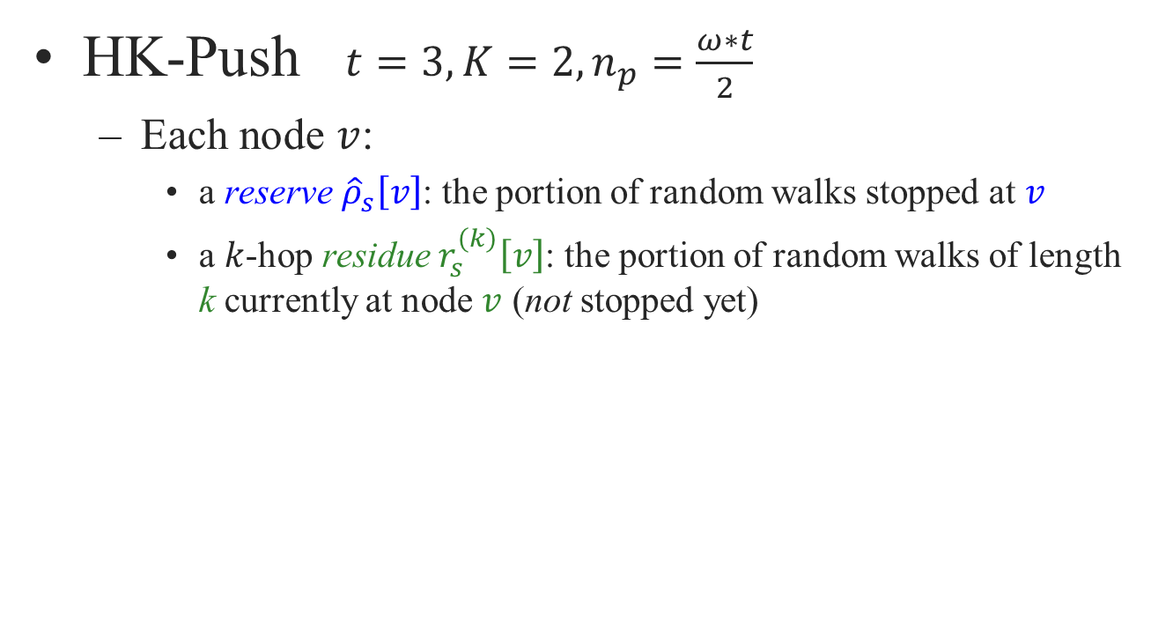
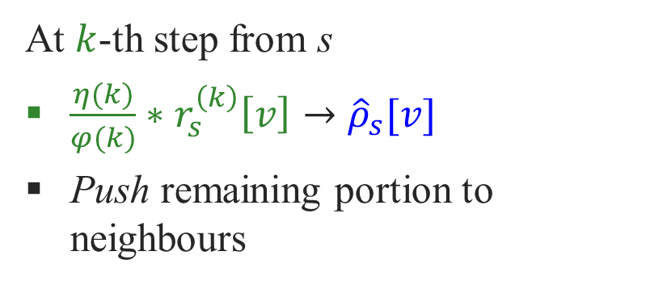
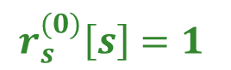
HK-Push: deterministic graph traversal
HK-Push $t=3,K=2,n_{p}=\frac{ω∗t}{2}$
Each node $v$:
a reserve ${\hat{ρ}}_{s}\left[v\right]$: the portion of random walks stopped at $v$
a $k$-hop residue $r_{s}^{(k)}\left[v\right]$: the portion of random walks of length k currently at node $v$ (not stopped yet)
$$r_{s}^{(0)}\left[s\right]=1$$
At $k$-th step from s
$\frac{η(k)}{φ(k)}∗r_{s}^{\left(k\right)}\left[v\right]→{\hat{ρ}}_{s}[v]$
Push remaining portion to neighbours
Notes:
Before presenting our solutions, we first introduce a deterministic graph traversal-based algorithm for computing HKPR.
Set t as 3, K, namely the max number of hops from s as 2, and the running cost of it as the half of the cost of Monte-Carlo approach.
During the course of the graph traversal, it maintains a reserve and a k-hop residue for each node, which represents the portion of random walks stopped at v and those that not stopped yet.
Initially, it sets the total residue at seed node s as 1, then converts a portion of the residue into the approximate HKPR and distributes the remaining residue to its all neighbors evenly.

Slide 11
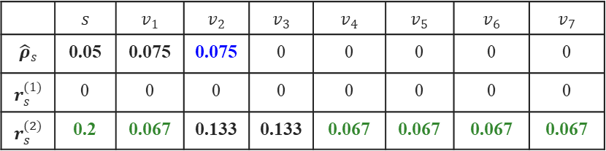
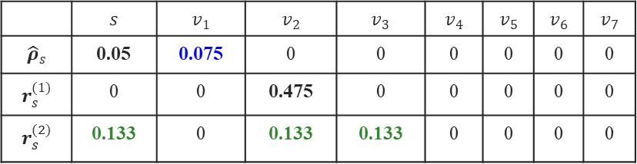
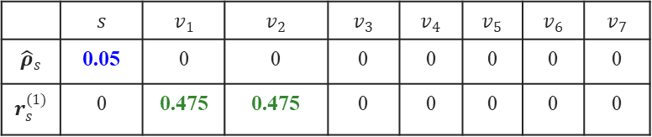
HK-Push: deterministic graph traversal
 | $$s$$ | $$v_{1}$$ | $$v_{2}$$ | $$v_{3}$$ | $$v_{4}$$ | $$v_{5}$$ | $$v_{6}$$ | $$v_{7}$$
$${\hat{ρ}}_{s}$$ | 0.05 | 0 | 0 | 0 | 0 | 0 | 0 | 0
$$r_{s}^{(1)}$$ | 0 | 0.475 | 0.475 | 0 | 0 | 0 | 0 | 0
1
 | $$s$$ | $$v_{1}$$ | $$v_{2}$$ | $$v_{3}$$ | $$v_{4}$$ | $$v_{5}$$ | $$v_{6}$$ | $$v_{7}$$
$${\hat{ρ}}_{s}$$ | 0.05 | 0.075 | 0 | 0 | 0 | 0 | 0 | 0
$$r_{s}^{(1)}$$ | 0 | 0 | 0.475 | 0 | 0 | 0 | 0 | 0
$$r_{s}^{(2)}$$ | 0.133 | 0 | 0.133 | 0.133 | 0 | 0 | 0 | 0
2
 | $$s$$ | $$v_{1}$$ | $$v_{2}$$ | $$v_{3}$$ | $$v_{4}$$ | $$v_{5}$$ | $$v_{6}$$ | $$v_{7}$$
$${\hat{ρ}}_{s}$$ | 0.05 | 0.075 | 0.075 | 0 | 0 | 0 | 0 | 0
$$r_{s}^{(1)}$$ | 0 | 0 | 0 | 0 | 0 | 0 | 0 | 0
$$r_{s}^{(2)}$$ | 0.2 | 0.067 | 0.133 | 0.133 | 0.067 | 0.067 | 0.067 | 0.067
3
Notes:
For example, in the first round, we keep 0.05 to s as the approximate HKPR of s and then propagates 0.475 residue to s’s two neighbors v1 and v2.
In the second round, we pick v1 and also 0.075 out of its residue as the approximate HKPR of v1, and sends 0.133 to its three neighbors s, v2, v3.
Now it proceeds to the next round, it picks v2 and converts 0.075 into its approximate HKPR and then distributes the remaining 0.4 to 6 nodes, namely s v1 v4 to v7 evenly, namely each of them receives 0.067 2-hop residue.
Since the max number of hops K is 2, HK-Push now terminates and returns the reserves as the estimated HKPR scores.

Slide 12
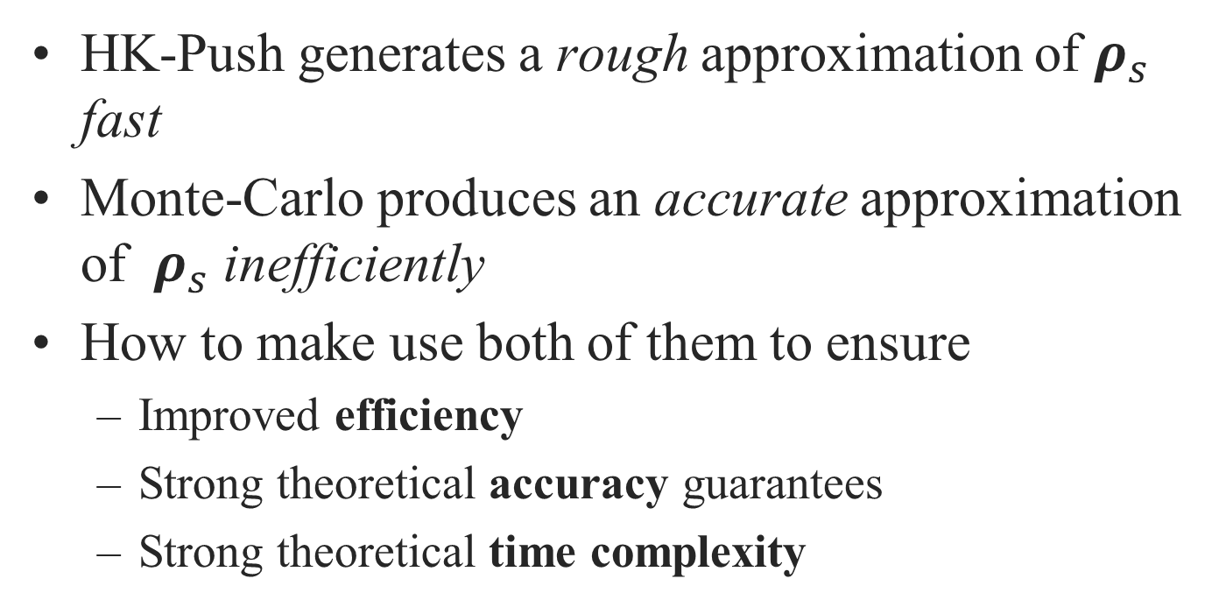
Challenges
HK-Push generates a rough approximation of $ρ_{s}$ fast
Monte-Carlo produces an accurate approximation of $ρ_{s}$ inefficiently
How to make use both of them to ensure
Improved efficiency
Strong theoretical accuracy guarantees
Strong theoretical time complexity
Notes:
Since HK-Push is able to generates a rough approximation of HKPR fast and Monte-Carlo is able to produces a result with rigorous accuracy guarantees.
A simple idea is just using HK-Push to derive a rough approximation of HKPR and then leveraging Monte-Carlo random walks to refine the outputs of HK-Push. Now the question becomes how to make this happen.

Slide 13
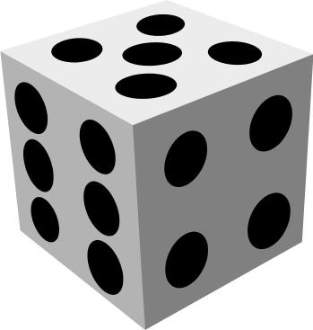
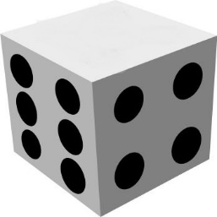
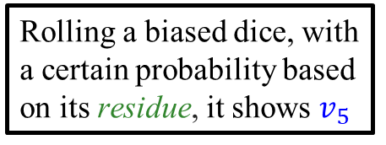


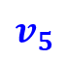
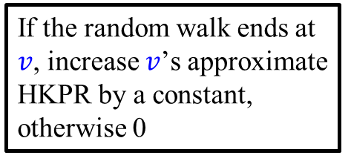
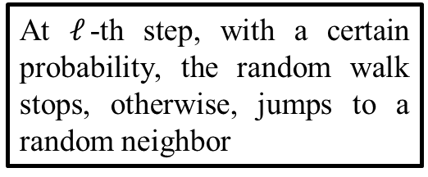
TEA: HK-Push + Random Walks
2
1
At $ℓ$-th step, with a certain probability, the random walk stops, otherwise, jumps to a random neighbor
Rolling a biased dice, with a certain probability based on its residue, it shows $v_{5}$
$$v_{5}$$
$$v_{5}$$
3
$$v$$
If the random walk ends at $v$, increase $v$’s approximate HKPR by a constant, otherwise 0
Notes:
The basic idea of our first solution TEA is as follows.
Based on the outputs of HK-Push, we first roll a biased dice and choose a node based on a certain probability, which depends on the residue of the node. Thus, we only care about the nodes with residues. For example, if the dice shows v5, we start a random walk from it, at each step, the random walk terminates with a certain probability or navigates to a random neighbor. In particular, if the random walk terminates at a node v, we increase v’s approximate HKPR score by a constant.

Slide 14
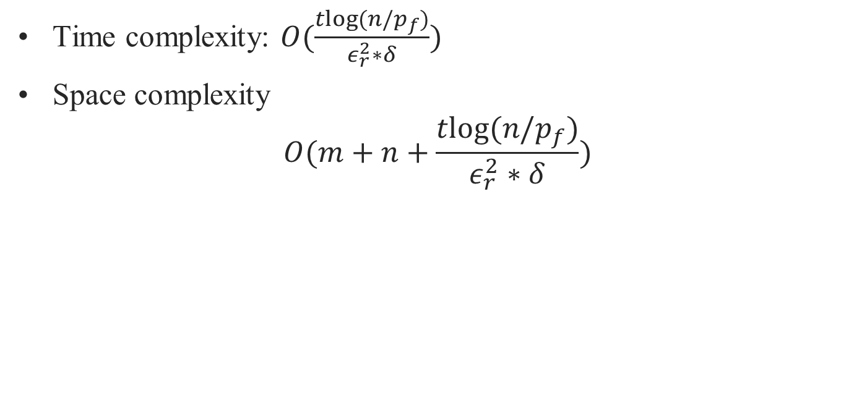
TEA: Analysis
Time complexity: $O(\frac{tlog(n/p_{f})}{ε_{r}^{2}∗δ})$
Space complexity $O(m+n+\frac{tlog(n/p_{f})}{ε_{r}^{2}∗δ})$
Still many random walks to perform. How to reduce the number of random walks without
increasing the cost of HK-Push, &
degrading theoretical guarantees ?
Notes:
The Time complexity of TEA is
The space complexity of it is
However, TEA still incurs expensive costs in random walks, which motivates us to a way to reduce the cost of random walks without increasing the cost of HK-Push and degrading the theoretical guarantees.

Slide 15
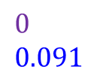
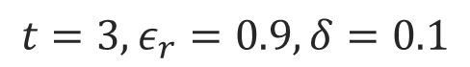
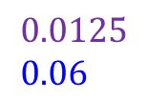
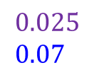
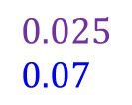
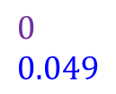
Our Observation
$$t=3, ε_{r}=0.9, δ=0.1$$
$$0.025 \\ 0.07$$
✔
✔
$$0.025 \\ 0.07$$
$$0.0125 \\ 0.06$$
✔
Approximate normalized HKPR
Exact normalized HKPR
✔
✘
$$0 \\ 0.091$$
$$0 \\ 0.049$$
Only node $v_{3}$ does not have an accurate approximate normalized HKPR
Notes:
We observe that we actually do not need so many random walks from each node. Let t=3, epsilon=0.9 and delta=0.1.
For instance, all nodes are marked as green because each of them has a residue, meaning that we still need to perform random walks from them.
Suppose the purple scores stand for the approximate degree normalized HKPR and the blue scores stand for the exact degree normalized HKPR,
By the definition of (d, epsilon, delta)-approximate HKPR, only node v3 does not have an accurate approximate degree normalized HKPR, which implies that many random walks are actually unnecessary.

Slide 16
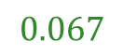
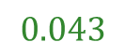



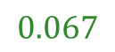
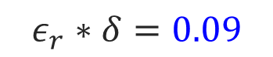
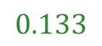
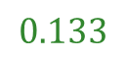
TEA+: Pruning Random Walks
$$t=3, ε_{r}=0.9, δ=0.1$$
$$0.2$$
$$0.02$$
$$0.067$$
$$0.133$$
$$0.133$$
$$0.043$$
$$0.067$$
$$ε_{r}∗δ=0.09$$
$$r_{s}^{(k)}\left[v\right]=\max{\{0,r_{s}^{\left(k\right)}\left[v\right]−0.09∗d(v)\}}$$
Notes:
Recall that the residue of a node is the portion of random walks that not stopped yet, as well as stands for the accuracy error.
Intuitively, we can prune random walks by reducing residues.
That is, we decrease a residue if it is above the error threshold, and remove a residue if it is below the error threshold.
Let the green scores stand for the residues. More specifically, if the residue is below the error threshold 0.09, we reset it to be 0, otherwise, we set the residue to be the old residue minus 0.09 times its degree.
By applying the above pruning strategy, we have an improved algorithm TEA+.

Slide 17

TEA+: Analysis
Time complexity: $O(\frac{tlog(n/p_{f})}{ε_{r}^{2}∗δ})$
Space complexity $O(m+n+\frac{tlog(n/p_{f})}{ε_{r}^{2}∗δ})$
Notes:
Since TEA+ is an optimized TEA with much less random walks, the time complexity of TEA+ would be the same as that of TEA. Although, they have same time complexities. TEA+ outperforms TEA significantly in practice.

Slide 18

Experimental Setup
Environment: a Linux server with a Intel 2.60GHz CPU and 64GB RAM.
Query set: 50 seed nodes uniformly at random as our query sets.
Our methods
TEA and TEA+ ($t=5,p_{f}={10}^{−6}$)
Competitors
Monte-Carlo: random walks (HKPR)
ClusterHKPR: truncated random walks (HKPR)
HK-Relax: deterministic graph traversal (HKPR)
SimpleLocal: three-stage local max flow
CRD: capacity releasing diffusion
Notes:
We run our algorithms against five competing algorithms, Monte-Carlo, ClusterHKPR, HK-Relax and two other algorithms that are not based on HKPR on a linux server with a single CPU and 64GB main memory.
We generate 50 seed nodes as the query set for each dataset and report the average running time and clustering quality..
Especially, following previous work, we set t, the expected random walk length as 5 and the failure probability of our algorithms as 1 over 1 million.

Slide 19

Datasets
Notes:
6 undirected real-world graphs used in recent work are considered, including small and large graphs, both of them are public available. PLC and 3D-grid are two synthetic graph.
PLC is generated with powerlaw degree distribution and approximate average clustering. 3D-grid is a synthetic grid graph in 3-dimensional space where every node has six edges, each connecting it to its 2 neighbors in each dimension.

Slide 20

Comparisons with Competitors
Notes:
This figure plots the average computational time and average clustering quality, namely conductance, of all algorithms when varying their error thresholds.
TEA+ consistently outperforms all competing algorithms in terms of running time and clustering quality significantly.

Slide 21
Summary
Efficient algorithm that offers theoretical guarantees on the normalized HKPR values
Efficient and effective algorithm for finding local clusters
Notes:
To conclude, we proposed an efficient algorithm for computing degree normalized HKPR with strong theoretical guarantees.
This algorithm also turns out to be an efficient solution for finding local clusters on large graphs.

Slide 22
Thanks
Q & A

Slide 23






Existing Work
ClusterHKPR [Chung et al. IWOCA’2014]
✔
$$v_{1}$$
3
$$\frac{16log⁡(n)}{ε^{3}}$$
K=4
4
$$v_{1}$$
✔
s
K-truncated random walks from seed node s
5
$$v_{2}$$
✘
5
$$v_{1}$$
✘
${\hat{ρ}}_{s}[v]$= Fraction of random walks stopping at $v$

Slide 24




Existing Work
HK-Relax [Kloster et al. KDD’2014]
Initial residue at $s→e^{−t}$
Residue $→$ reserve
At $k$-th step from $s$ residue $×\frac{t}{k+1}→$ neighbours
s
$$residue<r_{max}$$
$$k>K=3$$
${\hat{ρ}}_{s}[v]$= Sum of reserves at $v$

Slide 25





Why Accuracy Guarantees on normalized HKPR?
Exact HKPR
$$\left|{{\hat{ρ}}_{s}\left[v\right]−ρ}_{s}\left[v\right]\right|≤0.05$$
 | $$v_{1}$$ | $$v_{2}$$
$$ρ_{s}[v]$$ | 0.2 | 0.12
$$d(v)$$ | 5 | 2
$$\frac{ρ_{s[v]}}{d(v)}$$ | 0.04 | 0.06
 | $$v_{1}$$ | $$v_{2}$$
$${\hat{ρ}}_{s}[v]$$ | 0.25 | 0.08
$$d(v)$$ | 5 | 2
$$\frac{{\hat{ρ}}_{s[v]}}{d(v)}$$ | 0.05 | 0.04
$$<$$
$$>$$

Slide 26


Theoretical Guarantees
Algorithm | Accuracy Guarantee | Complexity
ClusterHKPR | $$ℙ[\left\{\begin{aligned}\left|{{\hat{ρ}}_{s}\left[v\right]−ρ}_{s}\left[v\right]\right|≤ε∗ρ_{s}\left[v\right], if ρ_{s}\left[v\right]>ε \\ \left|{{\hat{ρ}}_{s}\left[v\right]−ρ}_{s}\left[v\right]\right|≤ε, otherwise\end{aligned}]≥1−ε\right.$$ | $$O(\frac{tlog(n)}{ε^{3}})$$
HK-Relax | $$|\frac{{\hat{ρ}}_{s}\left[v\right]}{d(v)}−\frac{ρ_{s}[v]}{d(v)}|≤ε_{a}$$ | $$O(\frac{te^{t}log⁡(1/ε_{a})}{ε_{a}})$$
TEA & TEA+ | $$ℙ\left[\left\{\begin{aligned}\left|\frac{{\hat{ρ}}_{s}\left[v\right]}{d\left(v\right)}−\frac{ρ_{s}\left[v\right]}{d\left(v\right)}\right|≤ε_{r}∗\frac{ρ_{s}\left[v\right]}{d\left(v\right)}, if \frac{ρ_{s}\left[v\right]}{d\left(v\right)}>δ \\ \left|\frac{{\hat{ρ}}_{s}\left[v\right]}{d\left(v\right)}−\frac{ρ_{s}\left[v\right]}{d\left(v\right)}\right|≤ε_{r}∗δ , otherwise\end{aligned}\right.\right]≥1−p_{f}$$ | $$O(\frac{tlog(n/p_{f})}{ε_{r}^{2}∗δ})$$

Slide 27




HK-Push: deterministic graph traversal
Reserve ${\hat{ρ}}_{s}[v]$: the portion of random walks stopped at $v$
k-hop residue $r_{s}^{(k)}[v]$: the portion of random walks of length k currently at node $v$ (not stopped yet)
$$ρ_{s}\left[v\right]={\hat{ρ}}_{s}[v]\text{:}+\sum_{u∈G}{\sum_{k=0}^{K}{r_{s}^{(k)}[u]∗h_{u}^{\left(k\right)}[v]}}$$
error
Portion of random walks currently at $u$ at $k$-th step (not stopped yet)
Conditional probability that the random walk terminates at $v$ given its $k$-th hop at $u$

Slide 28




TEA: Rationale
$ρ_{s}\left[v\right]={\hat{ρ}}_{s}\left[v\right]+\sum_{u∈G}{\sum_{k=0}^{K}{r_{s}^{(k)}[u]∗h_{u}^{\left(k\right)}[v]}}$
$ρ_{s}\left[v\right]={\hat{ρ}}_{s}\left[v\right]+\sum_{u∈G}{\sum_{k=0}^{K}{r_{s}^{(k)}[u]∗h_{u}^{\left(k\right)}[v]}}$
Portion of random walks currently at $u$ at $k$-th step (not stopped yet)
Conditional probability that the random walk terminates at $v$ given its $k$-th hop at $u$
$$𝔼[X]≈\frac{\#(random walks ends at v)}{ω}$$

Slide 29





TEA+: Balancing HK-Push & Random walks
$$v_{1}$$
HK-Push Phase
Random walk Phase
$$v_{1}$$
s
$$v_{2}$$
$$v_{2}$$
${\frac{1}{m/n}}^{K/c}=ε_{r}∗δ$
#push-operations $n_{p}≤\frac{ω∗t}{2}$
K hops
half cost of random walks

Slide 30






TEA+: Pruning Random Walks
Intuition: pruning nodes that have sufficiently accurate ${\hat{ρ}}_{s}[v]$ (e.g., small residues)
$$ρ_{s}\left[v\right]={\hat{ρ}}_{s}\left[v\right]+\sum_{u∈G}{\sum_{k=0}^{K}{r_{s}^{(k)}[u]∗h_{u}^{\left(k\right)}[v]}}$$
$$\sum_{u∈G}{\sum_{k=0}^{K}{r_{s}^{(k)}[u]∗h_{u}^{\left(k\right)}[v]}}$$
$$\sum_{u∈G}{\sum_{k=0}^{K}{{rb}_{s}^{(k)}[u]∗h_{u}^{\left(k\right)}[v]}}$$
$max⁡\{0,r_{s}^{\left(k\right)}\left[u\right]−β_{k}∗ε_{r}δ∗d(u)\}$
$min⁡\{r_{s}^{\left(k\right)}\left[u\right], β_{k}∗ε_{r}δ∗d(u)\}$

Slide 31






TEA+: Pruning Random Walks
$$ρ_{s}\left[v\right]=q_{s}\left[v\right]+\sum_{u∈G}{\sum_{k=0}^{K}{r_{s}^{(k)}[u]∗h_{u}^{\left(k\right)}[v]}}$$
$$\sum_{u∈G}{\sum_{k=0}^{K}{r_{s}^{(k)}[u]∗h_{u}^{\left(k\right)}[v]}}$$
$$\sum_{u∈G}{\sum_{k=0}^{K}{{rb}_{s}^{(k)}[u]∗h_{u}^{\left(k\right)}[v]}}$$
If $r_{s}^{(k)}\left[u\right]$ becomes 0, meaning it’s accurate and no need for random walks
Otherwise, pruning $β_{k}∗ε_{r}δ∗d(u)$ portion of random walks
$∈[0,ε_{r}δ∗d(v)]$
Estimated as $0.5∗ε_{r}δ∗d(u)$

Slide 32





Our Observation
$$t=3, ε_{r}=0.9, δ=0.1$$
$$φ\left(C\right)=\frac{1}{3}$$
 | $$s$$ | $$v_{1}$$ | $$v_{2}$$ | $$v_{3}$$ | $$v_{4}$$ | $$v_{5}$$ | $$v_{6}$$ | $$v_{7}$$
$${\hat{ρ}}_{s}$$ | 0.05 | 0.075 | 0.075 | 0 | 0 | 0 | 0 | 0
$$r_{s}^{(1)}$$ | 0 | 0 | 0 | 0 | 0 | 0 | 0 | 0
$$r_{s}^{(2)}$$ | 0.2 | 0.067 | 0.133 | 0.133 | 0.067 | 0.067 | 0.067 | 0.067
✔
✘
✔
$$\left|\frac{{\hat{ρ}}_{s}\left[v\right]}{d\left(v\right)}−\frac{ρ_{s}\left[v\right]}{d\left(v\right)}\right|≤ε_{r}∗δ\text{=}\text{0.09}$$

Slide 33






TEA+: TEA + Pruning Random Walks
$$t=3, ε_{r}=0.9, δ=0.1$$
 | $$s$$ | $$v_{1}$$ | $$v_{2}$$ | $$v_{3}$$ | $$v_{4}$$ | $$v_{5}$$ | $$v_{6}$$ | $$v_{7}$$
$${\hat{ρ}}_{s}$$ | 0.05 | 0.075 | 0.075 | 0 | 0 | 0 | 0 | 0
$$r_{s}^{(1)}$$ | 0 | 0 | 0 | 0 | 0 | 0 | 0 | 0
$$r_{s}^{(2)}$$ | 0.2 | 0.067 | 0.133 | 0.133 | 0.067 | 0.067 | 0.067 | 0.067
$$v_{3}$$
$$ε_{r}∗δ=0.09$$
$$v$$
$$r_{s}^{(k)}\left[v\right]=\max{\{0,r_{s}^{\left(k\right)}\left[v\right]−0.09∗d(v)\}}$$
$$r_{s}^{(2)}$$ | 0.02 | 0 | 0 | 0.043 | 0 | 0 | 0 | 0
$α: 0.8→$ $0.063$ portion of random walks

Slide 34


Find A Cluster via the Sweep Cut
$$φ\left(C\right)=\frac{2}{6}=\frac{1}{3}$$
 | $$v_{3}$$ | $$v_{1}$$ | $$s$$ | $$v_{2}$$ | $$v_{4}$$ | $$v_{5}$$ | $$v_{6}$$ | $$v_{7}$$
$$\frac{{\hat{ρ}}_{s}}{d(v)}$$ | 0.04 | 0.032 | 0.03 | 0.025 | 0.01 | 0.01 | 0.01 | 0.01

Slide 35

TEA+: Analysis
Time complexity $O\left(n_{p}\right)+O\left(α∗ω∗t\right)=O(\frac{tlog(n/p_{f})}{ε_{r}^{2}∗δ})$
Space complexity $O\left(m+n\right)+O\left(n_{p}\right)+O\left(α∗ω∗t\right)$ $=O(m+n+\frac{tlog(n/p_{f})}{ε_{r}^{2}∗δ})$

Slide 36



Experimental Setup
Environment: a Linux server with a Intel 2.60GHz CPU and 64GB RAM.
Programming: C++ and g++ 4.8 with -O3 optimization.
Query set: 50 seed nodes uniformly at random as our query sets.
Our methods
TEA and TEA+ ($t=5,p_{f}={10}^{−6}$)
Competitors
Monte-Carlo: random walks
ClusterHKPR: truncated random walks
HK-Relax: deterministic graph traversal
SimpleLocal: three-stage local max flow
CRD: capacity releasing diffusion
$$ε_{r}=0.5, δ=2×\{{10}^{−8},{10}^{−7},{10}^{−6},{10}^{−5},{10}^{−4}\}$$
$$ε=\{0 . 005 , 0 . 01 , 0 . 02 , 0 . 05 , 0 . 1\}$$
$$ε_{a}=\{{10}^{−8},{10}^{−7},{10}^{−6},{10}^{−5},{10}^{−4}\}$$
$$δ=\{ 0 . 005 , 0 . 01 , 0 . 02 , 0 . 05 , 0 . 1 \}$$
$$T=\{ 7 , 10 , 15 , 20 , 30 \}$$

Slide 37

Ranking Accuracy of Normalized HKPR
Notes:
To explain why our algorithm TEA+ outperforms other methods in local graph clustering. We also evaluate the accuracy and efficiency of each method for computing degree normalized HKPR.
We evaluate the accuracy by comparing the output node ranking of each method with the ground-truth results using accuracy metric NDCG.
From the figure, we see that TEA+ is able to estimate degree-normalized HKPR efficiently and accurately.

Slide 38

Comparison between TEA and TEA+
Notes:
To demonstrate the power of our pruning random walks strategy in TEA+. We experimentally evaluate TEA+ against TEA in terms of running time when varying error threshold epsilon.
We observe that TEA+ is significantly faster than TEA on both small graphs and large graphs.

Slide 39

Comparisons with Competitors

Slide 40

TEA+ VS. FORA: Accuracy Guarantees
FORA: for each node’s PPR
TEA+: for each node’s normalized HKPR
$$ℙ\left[\left|π_{s}\left[v\right]−{\hat{π}}_{s}\left[v\right]\right|≤ε_{r}∗π_{s}\left[v\right] ,if π_{s}\left[v\right]>δ\right]≥1−p_{f}$$
$$ℙ\left[\left\{\begin{aligned}\left|\frac{{\hat{ρ}}_{s}\left[v\right]}{d\left(v\right)}−\frac{ρ_{s}\left[v\right]}{d\left(v\right)}\right|≤ε_{r}∗\frac{ρ_{s}\left[v\right]}{d\left(v\right)}, if \frac{ρ_{s}\left[v\right]}{d\left(v\right)}>δ \\ \left|\frac{{\hat{ρ}}_{s}\left[v\right]}{d\left(v\right)}−\frac{ρ_{s}\left[v\right]}{d\left(v\right)}\right|≤ε_{r}∗δ , otherwise\end{aligned}\right.\right]≥1−p_{f}$$

Slide 41


TEA+ VS. FORA: Markovianness
FORA is devised for computing PPR
TEA+ is devised for computing HKPR
$$π\left(s,v\right)=ℙ[Random walk from s stops at v]$$
In each step, the random walk terminates with probability $α∈(0,1)$, regardless of the previous step
$ρ_{s}\left[v\right]=ℙ$[Random walk of length-$k$ from $s$ stops at $v$]
In $k$-th step, the random walk terminates with a probability that depends on previous step

Slide 42
TEA+ VS. FORA: Residues
FORA:
Forward-Push produces a single residue vector
TEA+:
HK-Push generates K residue vectors

